Slide 1
Boolean Addition and Multiplication
The OR operation is often called Boolean addition. Variables that are ORed together form a sum term.
The AND operation is often called Boolean multiplication. Variables that are ANDed together form a product term.
The expression (A+B+C)(D+E) is the product of two sum terms.
The expression AB + CD + AD is the sum of three product terms.

Slide 2
Commutative Laws
The commutative law of addition states that
The order in which variables are ORed makes no difference.
A + B = B + A
The commutative law of multiplication states that
The order in which variables are ANDed makes no difference.
AB = BA
Notes:
Show what this means in terms of gates.

Slide 3
Associative Laws
The associative law of addition states that
When ORing more than two variables, the result is the same regardless of the grouping of the variables.
A + (B +C) = (A + B) + C
The associative law of multiplication states that
When ANDing more than two variables, the result is the same regardless of the grouping of the variables.
A(BC) = (AB)C
Notes:
Show what this means in terms of gates.

Slide 4
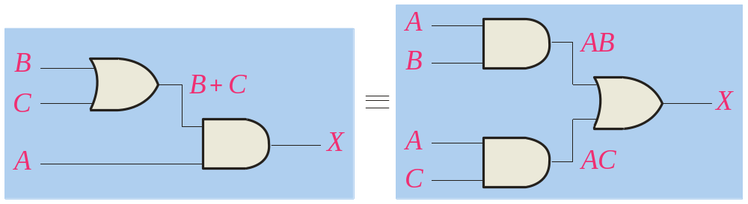
Distributive Law
The distributive law is the factoring law. A common variable can be factored from an expression just as in ordinary algebra. That is
AB + AC = A(B+ C)
The distributive law can be illustrated with equivalent circuits:
A(B+ C)
AB + AC

Slide 5
Rules of Boolean Algebra
1. A ^{. 0 = 0}
7. A ^{. A = 0}
2. A ^{. 1 = A}
8. A + A = 1
=
3. A + 0 = A
9. A = A
4. A + 1 = 1
10. A + AB = A + B
5. A ^{. A = A}
6. A + A = A
Notes:
-Discuss Rules 1 to 9 in terms of truth tables of basic gates.
-Rules 10 can be derived from the others; it’s a shortcut rule that may be useful.

Slide 6
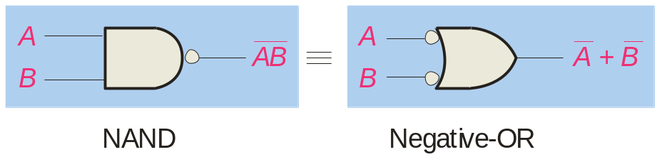
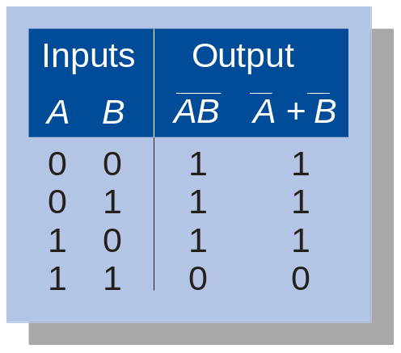
DeMorgan’s Theorems
DeMorgan’s 1^{st Theorem}
The complement of a product of variables is equal to the sum of the complemented variables.
AB = A + B
Applying DeMorgan’s first theorem to gates:
Notes:
-Here it’s written for 2 terms, but it applies to any number of terms: e.g., (ABC)’ = A’ + B’ + C’

Slide 7
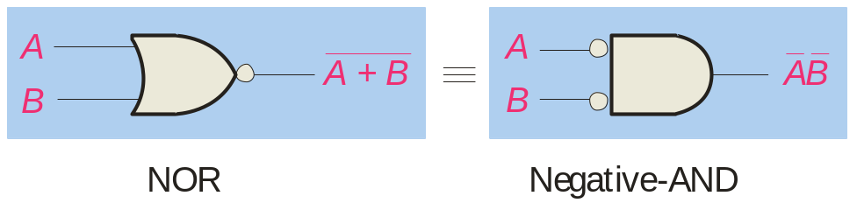
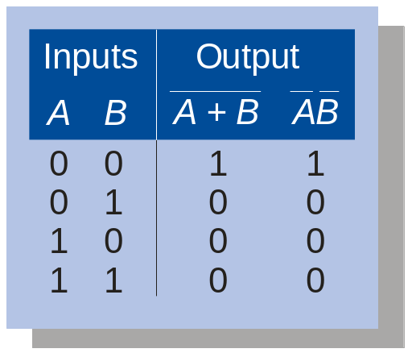
DeMorgan’s Theorems
DeMorgan’s 2^{nd Theorem}
The complement of a sum of variables is equal to the product of the complemented variables.
A + B = A ^{. B}
Applying DeMorgan’s second theorem to gates:
Notes:
-Here it’s written for 2 terms, but it applies to any number of terms: e.g., (A+B+C)’ = A’B’C’

Slide 8
DeMorgan’s Theorem
Example
Apply DeMorgan’s theorem to remove the overbar covering both terms from the
expression X = C + D.
Solution
To apply DeMorgan’s theorem to the expression, you can break the overbar covering both terms and change the sign between the terms. This results in
X = C . D. Deleting the double bar gives X = C . D.
=
Notes:
-Another example: ((A+B)C)’ = A’B’ + C’
-Another example: (AB’ + C’D)’ = (A’+B)(C+D’)

Slide 9
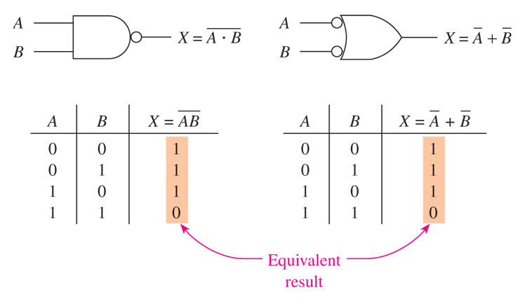
NAND equals “Negative OR”

Slide 10
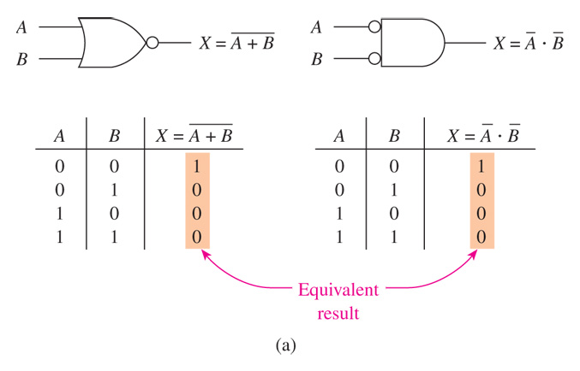
NOR equals “Negative AND”

Slide 11
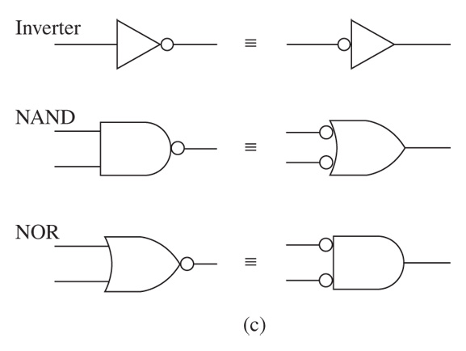
Alternative Symbols for Inverter, NAND, and NOR

Slide 12

Boolean Analysis of Logic Circuits
Combinational logic circuits can be analyzed by writing the expression for each gate and combining the expressions according to the rules for Boolean algebra.
Example
Apply Boolean algebra to derive the expression for X.
Solution
Write the expression for each gate:
(A + B )
C (A + B )
X
= C (A + B )+ D
Applying DeMorgan’s theorem and the distribution law:
X = C (A B) + D = A B C + D

Slide 13
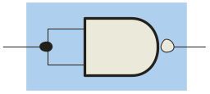
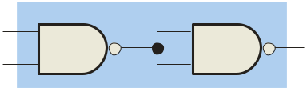
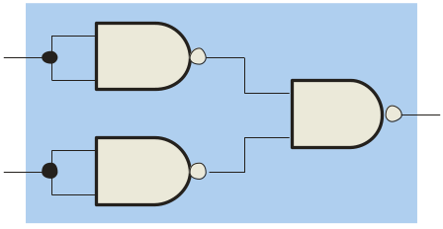
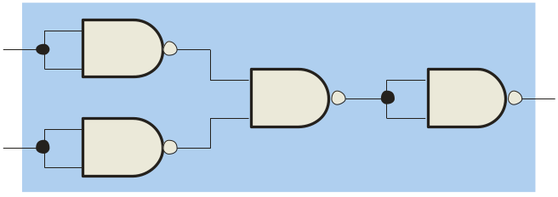
Universal Gates
NAND gates are sometimes called universal gates because they can be used to produce the other basic Boolean functions.
A
A
A
AB
B
Inverter
AND gate
A
A
A + B
A + B
B
B
OR gate
NOR gate
Notes:
Show how to use Multisim’s logic converter to generate NAND-only logic circuits.

Slide 14
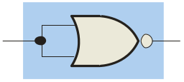
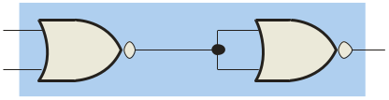
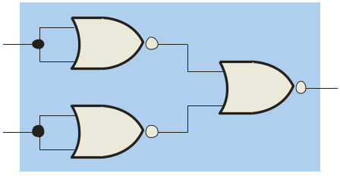
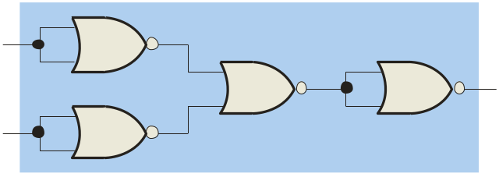
Universal Gates
NOR gates are also universal gates and can form all of the basic gates.
A
A
A
A + B
B
Inverter
OR gate
A
A
AB
AB
B
B
AND gate
NAND gate

Slide 15
Simplifying NAND Circuits
Recall that, according to Demorgan’s theorem, the following two representations of a NAND gate are equivalent:
In many cases, this lets you redraw all-NAND circuits in ways that are much easier to read. See example on next slide.

Slide 16
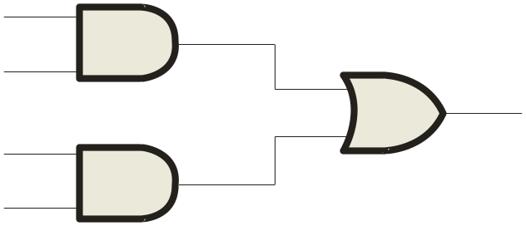
Simplifying NAND Circuits
For example, the following circuit uses the two equivalent symbols for a NAND gate:
A
C
X =
C
A
+
A
B
A
B
The logic is easy to read if you (mentally) cancel the two connected bubbles on a line.

Slide 17
Sum-of-Products form
A Boolean expression is in sum-of-products form (SOP) when it’s written as the sum of one or more products. In SOP form, an overbar cannot extend over more than one variable.
Examples of expressions in SOP form:
A B C + A B A B C + C D AB +AC + D
The book also discusses product-of-sums form (POS), in which two or more sum terms are multiplied, as in the following examples:
SOP form is far more useful than POS form.
(A + B)(A + C) (A + B + C)(B + D) (A + B)(B+C)D
Notes:
-The K-map technique requires you first to put your expression in SOP form.

Slide 18
SOP and POS forms
Many Boolean expressions are in neither SOP form nor POS form.
Examples: AB + C and AB + C(AD + BD)
But every expression can be converted to SOP form by applying the distributive law and DeMorgan’s theorems.
Notes:
-Convert the slide’s two examples to SOP form: A’C’ + B’C’ and AB + A’CD + BCD’.
-Set up these 2 examples to both sides of the screen.

Slide 19
REVIEW: Writing the SOP Expression for any Truth Table
Given the truth table for a circuit, it’s easy to write an SOP-form expression for that circuit.
Step 1. For each of the truth table’s rows with a 1 in the output column, list the corresponding product term of the input variables.
Step 2. Add all of the product terms from Step 1.
See example on next slide…

Slide 20
Example: Writing the SOP Expression for a Truth Table
A | B | C | X
0 | 0 | 0 | 0
0 | 0 | 1 | 0
0 | 1 | 0 | 1
0 | 1 | 1 | 1
1 | 0 | 0 | 0
1 | 0 | 1 | 1
1 | 1 | 0 | 0
1 | 1 | 1 | 0

Slide 21
Writing the Truth Table for any SOP Expression
Given an SOP expression , it’s easy to write the truth table.
Step 1. Based on the number of input variables, build the truth table’s input columns.
Step 2. For each product term in the SOP expression, place a 1 in the truth table’s output column for all rows that make the product term a 1.
Step 3. After completing Step 2 for all product terms in the SOP expression, place a 0 in the output column for all other rows.
Notes:
-Do this with the two examples given above, and use Multisim to check.

Slide 22
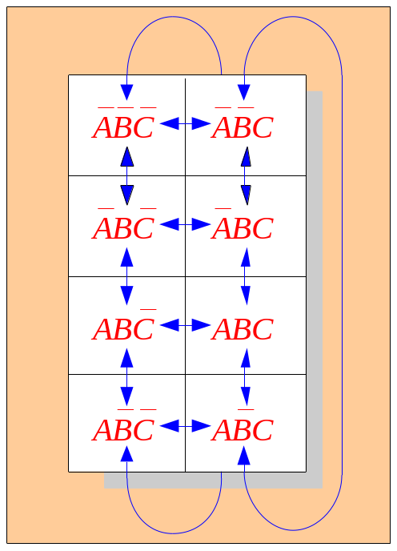
Karnaugh maps
The Karnaugh map (K-map) is a tool for simplifying expressions with 3 or 4 variables. For 3 variables, 8 cells are required (2^{3).}
The map shown is for three variables labeled A, B, and C. Each cell represents one possible product term.
Each cell differs from an adjacent cell by only one variable.
Notes:
-Of the two techniques for logic simplification, Boolean algebra requires ingenuity, and in some cases it’s hard to know when you’re finished; K-maps give us a mechanical procedure.
To create the K-map to simplify an expression, you must first get the expression in SOP form.

Slide 23
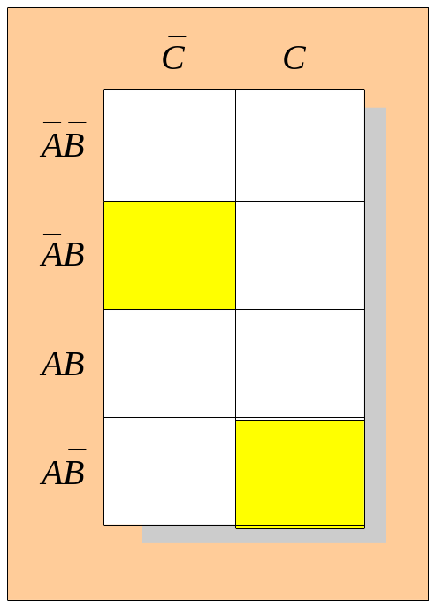
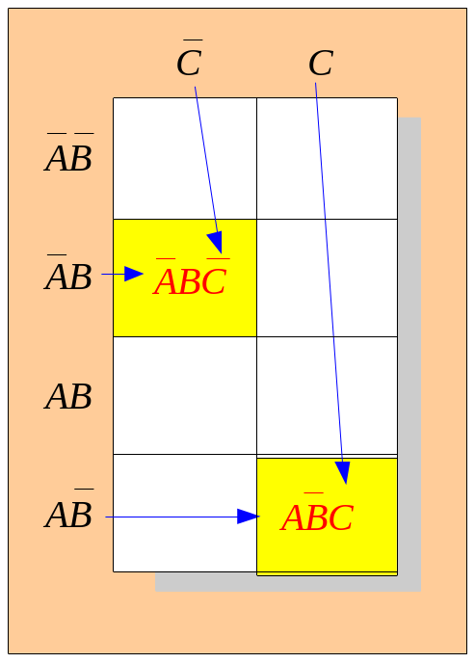
Karnaugh maps
Cells in a K-map must be labeled in the order shown.
C C
Example
Read the terms for the yellow cells.
AB
AB
AB
AB
Solution
The cells are ABC and ABC.

Slide 24
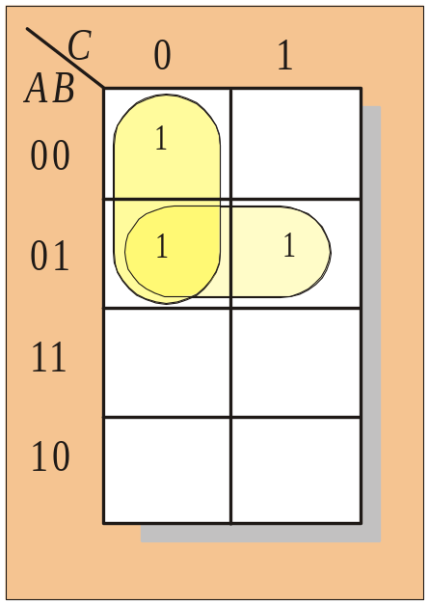
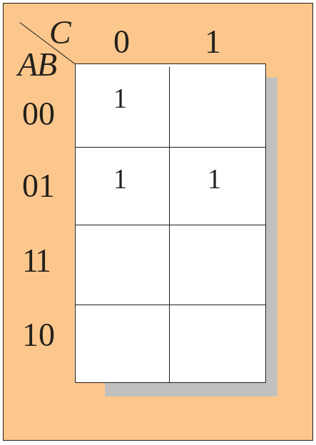
Karnaugh maps
K-maps can simplify combinational logic by grouping cells and eliminating variables that change.
Example
Group the 1’s on the map and read the minimum logic.
Solution
1. Group the 1’s into two overlapping groups as indicated.
Read each group by eliminating any variable that changes across a boundary.
B changes across this boundary
The vertical group is read AC.
C changes across this boundary
The horizontal group is read AB.
X = AC +AB

Slide 25
Karnaugh Map Procedure
If you’re starting with a Boolean expression that is not in SOP form, convert it to SOP form.
Set up the K-map, labeling its rows and columns.
Place 1s in the appropriate squares.
Group adjacent 1s in groups of 8, 4, 2, or 1. You want to maximize the size of the groups and minimize the number of groups. Follow this order:
  Circle any octet.
  Circle any quad that contains one or more 1s that haven’t already been circled, using the minimum number of circles.
  Circle any pair that contains one or more 1s that haven’t already been circled, using the minimum number of circles.
  Circle any isolated 1s that haven’t already been circled.
Read off the term for each group by including only those complemented or uncomplemented variables that do not change throughout the group.
Form the OR sum of the terms generated in Step 5.
Notes:
Do the two examples from above.

Slide 26
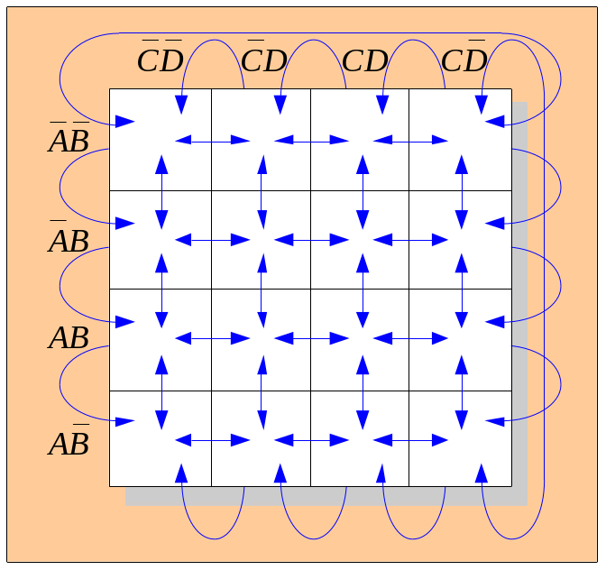
Karnaugh maps
A 4-variable map has an adjacent cell on each of its four boundaries as shown.
Each cell is different only by one variable from an adjacent cell.
Grouping follows the rules given in the text.
The following slide shows an example of reading a four variable map using binary numbers for the variables…

Slide 27
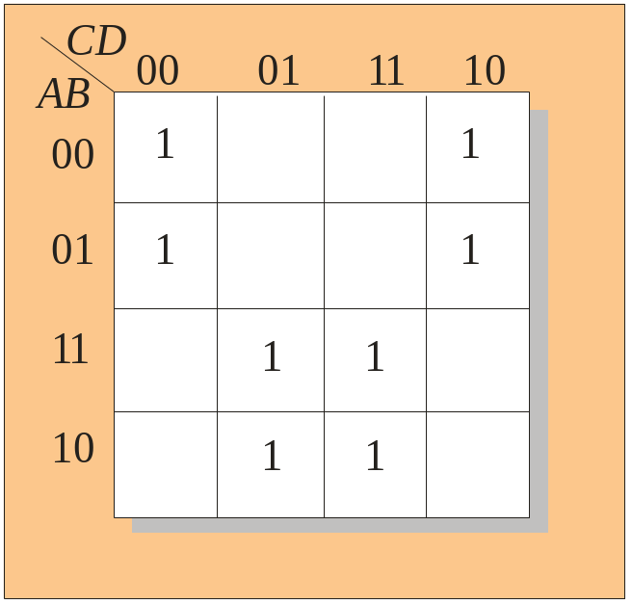
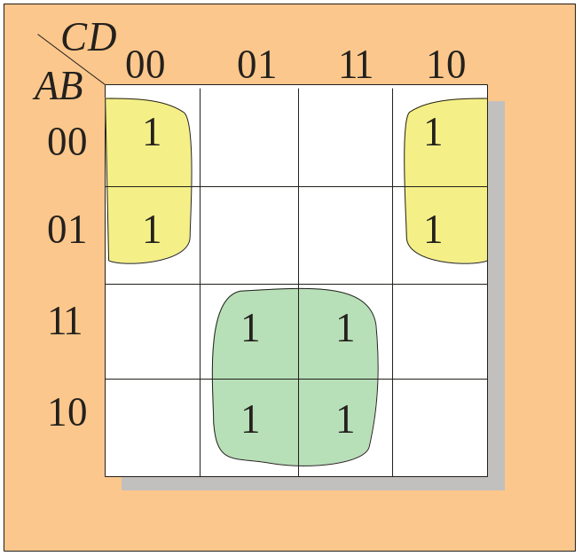
Karnaugh maps
Example
Group the 1’s on the map and read the minimum logic.
C changes across outer boundary
Solution
1. Group the 1’s into two separate groups as indicated.
Read each group by eliminating any variable that changes across a boundary.
B changes
B changes
The upper (yellow) group is read as AD.
The lower (green) group is read as AD.
C changes
X
X = AD +AD

